Slide 1
Manhattan WMS Training

Slide 2
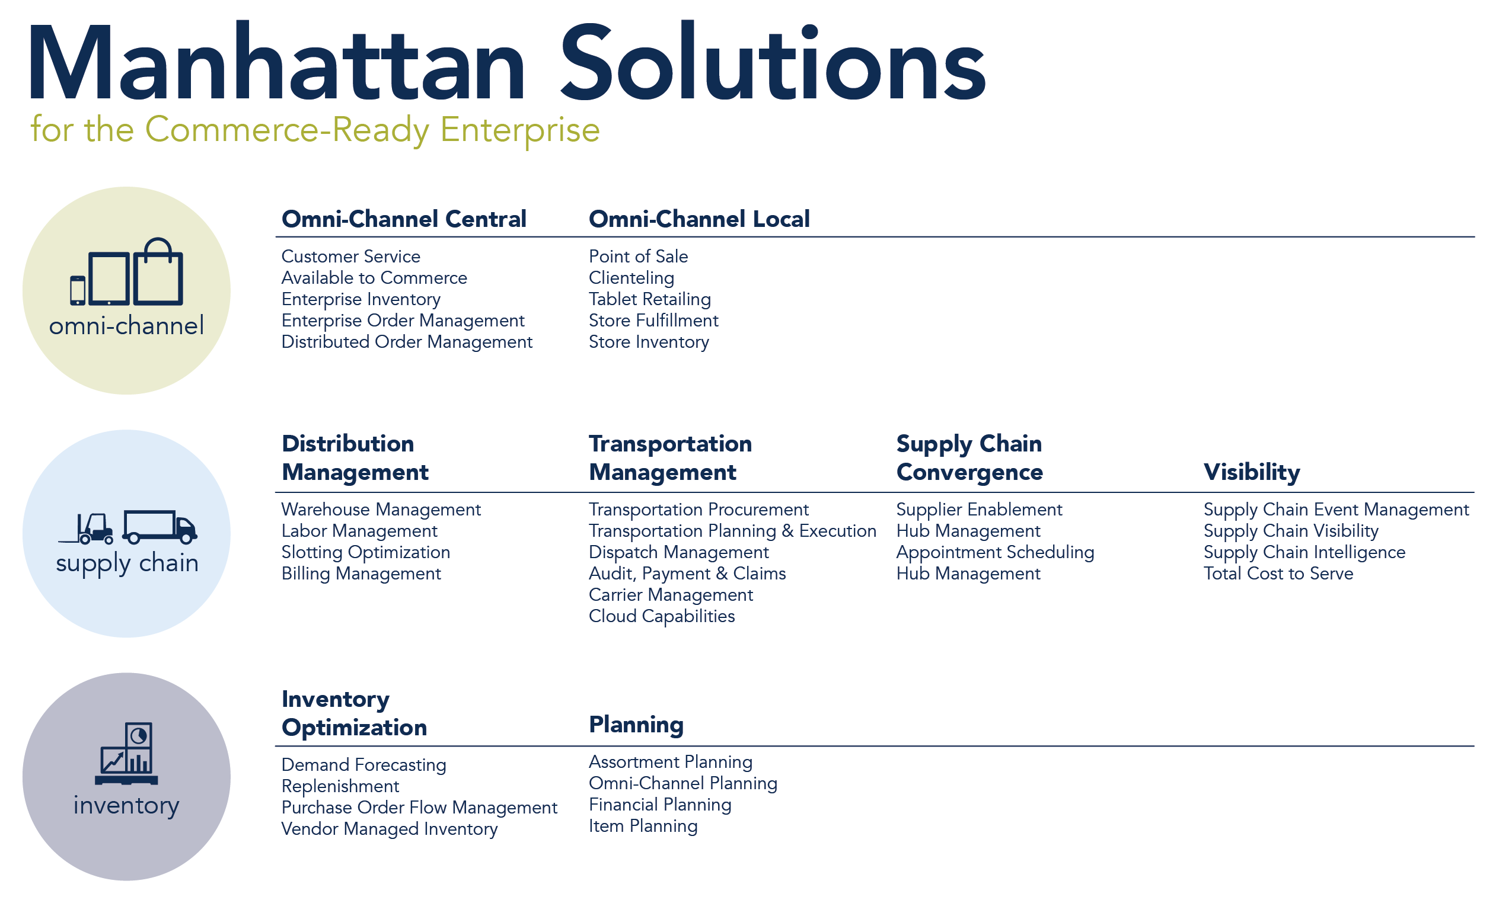

Slide 3
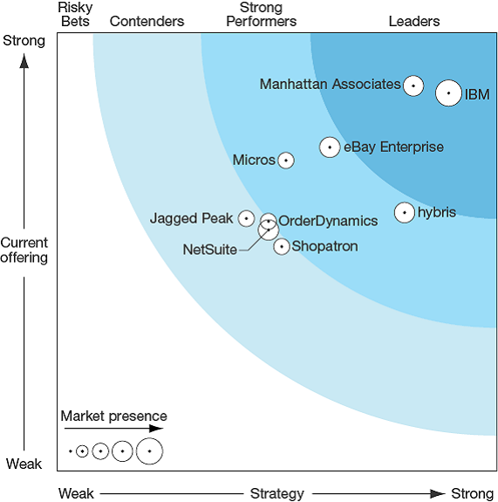
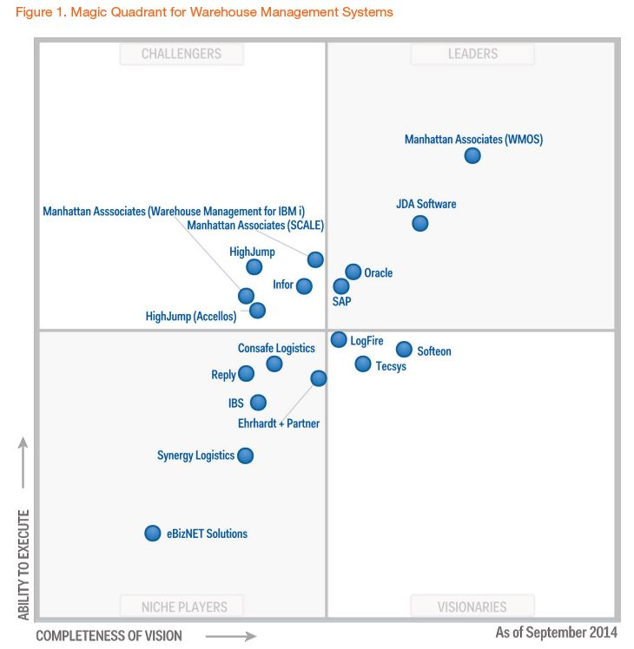
Your Single Solution to Manage Orders, Fulfillment, & Customer Service
Market Leading Omni OMS +
Market Leading WMS

Slide 4
WM Module Overview
INBOUND
Receiving
Palletization
Inventory Management
Appointment Scheduling
Putaway
Cycle Count
Physical Inventory
Value Added Services
Task Management
TRANSPORTATION EXECUTION
OUTBOUND
Carrier Selection/Routing
BOL/Manifest
Wave
Management
Picking
Value Added Services
Replenishment
Packing
Consolidation
Staging
Loading
Load Planning
& Dock Door
Management
Freight
Charges
PARCEL SHIPPING

Slide 5
Inbound
WM’s Inbound functions include:
Pre-Receiving and Receiving functions
Appointment Scheduling
Putaway
Inventory Management
Cycle Counting

Slide 6
Outbound
2. WM’s Outbound functions include:
Waves
Replenishment
Picking and Packing
Ship Confirmation

Slide 7
General Setup

Slide 8
Terminology
Term | Definition
UI | User interface for the web based application accessed through computer terminals.
RF | Transactions executed through radio frequency hand held devices.
Item | Unique system identifier for product within the warehouse.
Reserve Location | Reserve locations are systemic areas in which license plated inventory is stored.
Pick Location | Pick locations are systemic areas assigned by SKU storing inventory from which less than license plate quantities are picked.

Slide 9

Item Master
Dimensions
Weight
Volume
Length, Width, Height
Business Partner
Vendor Item #
Internal Item#
Multiple UPC Barcodes
Item Zoning
Putaway Types
Preferred Locations
Unit of Measure
Receipt
Storage
Pick & Ship
Cycle Count
Last Date
Next Date
Scheduled Count Period
Less than 'N'
Control
Lot # Control
Exp. Date Control
Weights
Serial Number all or some

Slide 10
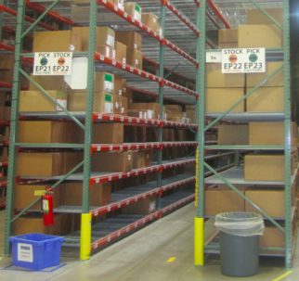
Location Profile:
Dimensions
Volume
L x W x H
General
Type
Location Number Role
Sequencing
Putaway
Picking
X,Y,Z Coordinates
Facility Codes
Receipt
Storage
Pick & Ship
Cycle Count
Next Date
Scheduled
Complete
Replenishment
Item
Quantity
Unit of Measure

Slide 11
Inbound Interface Summary
Items (Download)
ASN (Download)
Host
WM
Pix (Upload)

Slide 12
Items
List of all Valid Items in the Warehouse
Host
WM
Item Master
Item | Description
111 01232 | Soccer Ball
123 48274 | Pro Basketball
456 12345 | Tennis Ball
789 12884 | Pro Volleyball

Slide 13
Advanced Shipment Notice (ASN)
Advanced visibility of inbound shipments
Quick reconciliation of actual vs. expected
Improved resource management
Improved outbound planning
Purchase Orders / ASNs / Shipments

Slide 14
Perpetual Inventory Transactions (PIX)
Host
WM
Provide real time updates to host system.
Inventory transactions
Informational PIX

Slide 15
Outbound Interface
Outbound Interfaces
Distribution Orders
Ship Confirmation
Inbound/Outbound Interface Summary

Slide 16
Outbound Interface Summary
Distribution Order (download)
Host
(ICM/OMS/PFI)
WM
Ship Confirmation (upload)

Slide 17
Distribution Order
A Distribution Order is simply an order in WM
Customer
Order
Entry
Host
Soft
Allocation
WM

Slide 18
Distribution Order: Customer Order
Customer information
Order details
Customer or order specific instructions
Host
WM

Slide 19
Inbound/Outbound Interfaces
Item (inbound)
ASN (inbound)
HOST
WM
PIX (inbound)
Distribution Order (outbound)
Ship Confirmation (outbound)

Slide 20
Basic Configuration Element
Describe Transactions
Strategy & Criteria
Menu Items
Mobile Menu Maintenance

Slide 21
One Inventory Bucket
iLPN
Active/Case Pick
All four buckets equal
WM INVENTORY
Inbound Receipts and Storage
Unit and Full Case Pick
Transitional
oLPN
Value Added Services and Work Orders
Outbound Containers

Slide 22
iLPN Inventory
LPN ID
LPN ID (Pallet)
PALLET ID
(Nested LPNs)
LPN ID
(Trolley)

Slide 23
Active Inventory
UNIT PICK
Reserve
Flow Rack
Shelf Pick

Slide 24
Transitional Inventory
Value Added Services
Inventory Errors

Slide 25
Four-Wall Inventory
The sum of all types of inventory.
Active/Reserve
iLPN
oLPN
Transitional

Slide 26
Pre-Receiving

Slide 27
Terminology
Term | Definition
ASN | Advanced shipment notice which uniquely identifies an inbound delivery of inventory to the warehouse.
PO | Purchase Orders represent an agreed upon set of inventory to be sent from origin vendor to destination warehouse.
Appointment | Appointments associate a carrier trailer to its contents and associated times of arrival/departure.

Slide 28
Advanced Shipment Notices
ASN is needed to receive inventory
‘Shipment’ represents one trailer or container
Shipment may contain multiple ASNs
Receiving can be initiated against either an ASN or a Shipment

Slide 29

ASN/PO Relationship
WM ASN
Purchase Order 1
Purchase Order 2
Purchase Order 3
1 ASN per Trailer
Multiple POs per ASN

Slide 30
Shipment/PO/ASN Relationship
WM Shipment
ASN 1
ASN 2
Purchase Order 1
Purchase Order 3
Purchase Order 2
Multiple ASNs per WM Shipment
Multiple POs per ASN
Same PO across multiple ASNs and Multiple WM Shipments

Slide 31
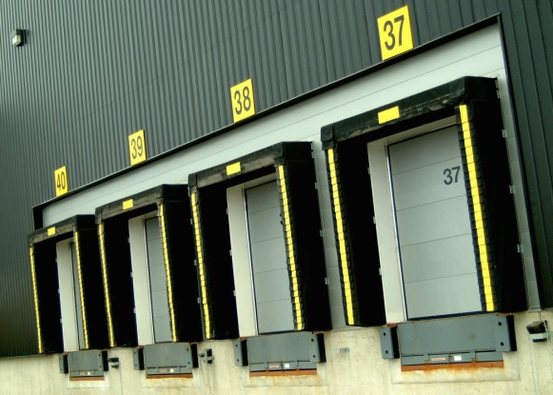
Advanced Shipment Notices
Receiving Scenarios:
Warehouse: may or may not know details about shipment
1. Shipment is on its way…
Warehouse: has to receive shipment
2. Shipment arrives

Slide 32
Advanced Shipment Notices
Receiving Scenarios:
How does WM handle this?
Best case:
You’re handed a packing slip that details:
Shipment
Items with
quantities at the iLPN level
Next best case:
The packing slip contains:
Shipment
Items
Total count of each item
Worst case scenario:
Some stuff shows up; verify against a PO

Slide 33
Advanced Shipment Notices
In WM, we handle the scenarios with 3 types of ASNs:
iLPN Level
Item Level
Blind Receipt
Note: The type of ASN determines what data will be prompted for during the receiving process.

Slide 34
iLPN Level ASN
Advanced Shipment Notices
Ideal scenario!!
Greatest level of detail about a shipment
Allows for greatest level of verification
Defines the shipment at iLPN level
iLPN/Item(SKU)/Qty
Can validate shipment
iLPN level
iLPN/Item(SKU)/Qty level

Slide 35
iLPN Level ASN
Before Receiving:
Provides details of a shipment at the aggregate Item/Quantity level.
Provides details of a shipment at the iLPN level
Packing Slip
iLPN Level ASN
Ted Bears Inc.
Shipment #: S1001035
P.O.: 15263748
2 Cases
25 – SKU XX Teddy Bears
25 –SKU XX Teddy Bears
Shipment Number SKU Quantity
50
S1001035
Teddy Bears
✓
✓
ASN_HDR/DTL
LPN/LPN_DTL
PO_HDR/DTL

Slide 36
The Item Level ASN:
Advanced Shipment Notices
Defines shipment at Item (SKU) level
No information about individual iLPNs
Validate Item and quantity at receipt
Enter iLPN information at receipt

Slide 37
Item Level ASN
Before Receiving:
Provides details of a shipment at the aggregate Item/Quantity level.
ILPN labels must be applied at the time of receiving.
Packing Slip
Item Level ASN
Vendor: Ted Bears Inc.
Shipment #: S1001035
P.O.: 15263748
50 – Teddy Bears
Shipment Number SKU Quantity
50
S1001035
Teddy Bears
✓
ASN_HDR/DTL
LPN/LPN_DTL
PO_HDR/DTL

Slide 38
Blind Receipt
Advanced Shipment Notices
Receive without pre-existing ASN
Provides the least validation
SKU and quantity against PO
ASN created in background during receiving

Slide 39
Blind Receipt
Advanced Shipment Notices
Shipment Number ??? Item ??? Quantity ???
Note: Customer returns can also be received as a blind receipt.

Slide 40
Blind Receipt
Before Receiving:
Provides NO details
The shipment just shows up at the dock
Packing Slip
Shipment Number SKU Quantity
Blind Receipt
Vendor: Ted Bears Inc.
Shipment #: S1001035
P.O.: 15263748
50
S1001035
Teddy Bears
ASN_HDR/DTL
LPN/LPN_DTL
PO_HDR/DTL

Slide 41

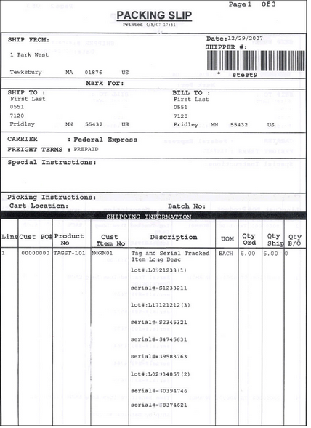
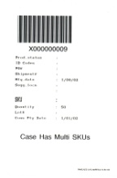
ASNs
LPN Level
Contents of each iLPN known prior to receipt
Receiving acknowledges receipt of iLPN contents into warehouse inventory
Item Level
Contents of each iLPN not known prior to receipt
Receiving builds iLPN as well as acknowledges receipt of iLPN contents into warehouse inventory

Slide 42
Purchase Orders
Track receipts at PO level
Provide SKU and quantity tolerance checks.
Can use PO to build ASN.
WM allows:
One PO received over multiple ASNs
Multiple POs on one ASN
Multiple POs on one Shipment
PO is SKU level only, no iLPN information

Slide 43
Create ASN from Purchase Order
Process:
Typically created off of Packing Slip
Next-up ASN Number
Ties items and quantities from Packing Slip to a receiving entity (ASN)
Benefits:
Creates an entity to receive & verify against
ASNs drive many processes within WM

Slide 44
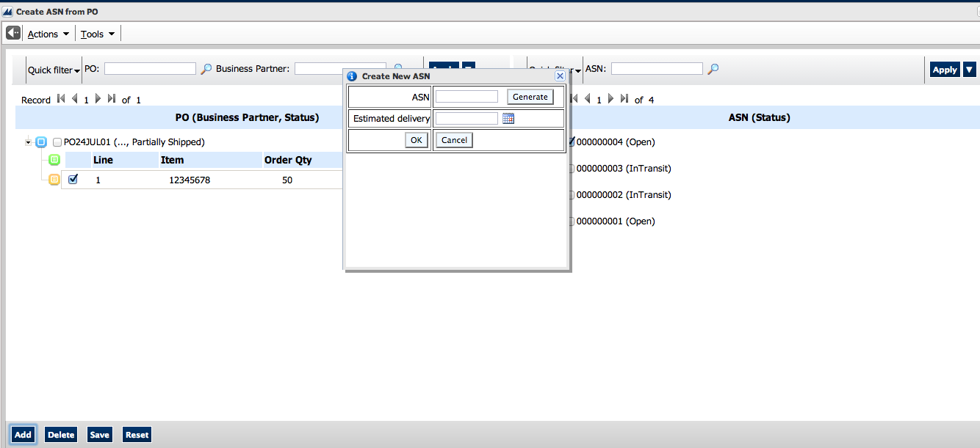
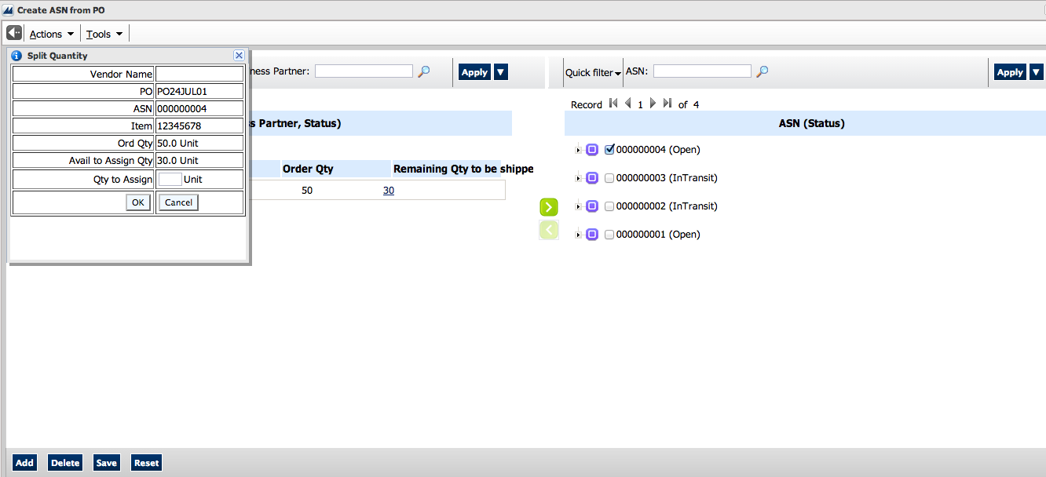
Create ASN from Purchase Order
Generate ASN number or add to already created ASN
Add Entire PO or PO Line by drag & drop
Add partial PO line quantity through the split function

Slide 45
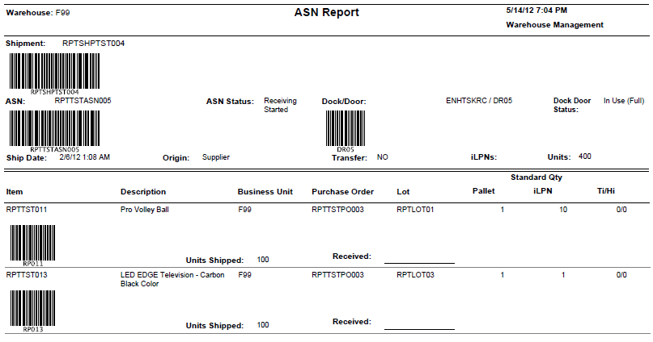
ASN Inquiry Report
Assists in the receiving process (especially for Item Level ASNs)
Contains barcodes for Shipment, ASN, Dock Door and Item

Slide 46

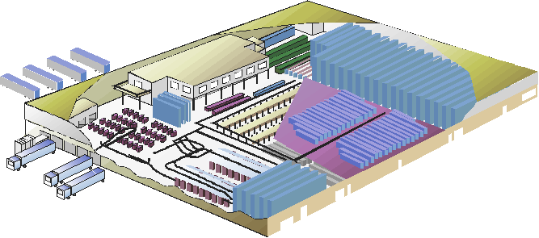
Appointments Scheduling and Yard Management
Schedule & manage WM shipment appointments
Optimize dock door assignments
Inbound & outbound yard management
Trailer tracking
Manage dock door availability
Guard Check-in
RF directed tasks for yard associates

Slide 47
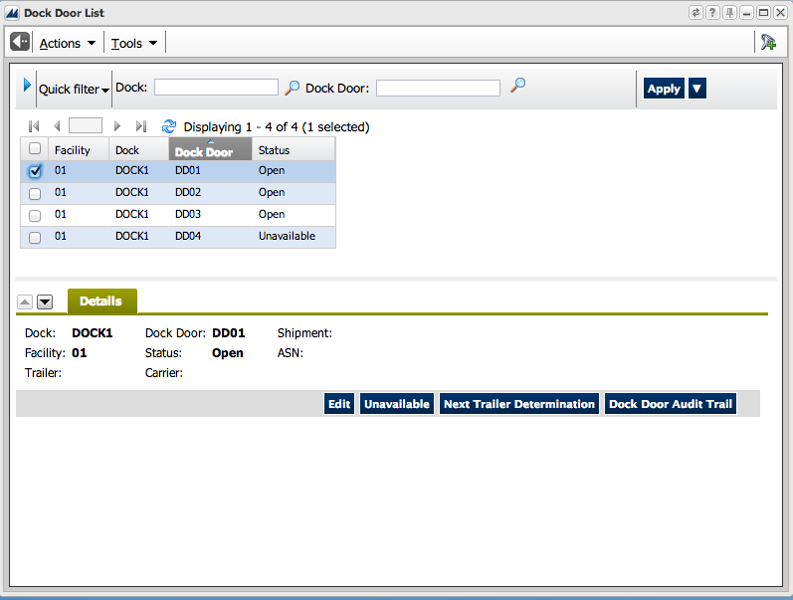
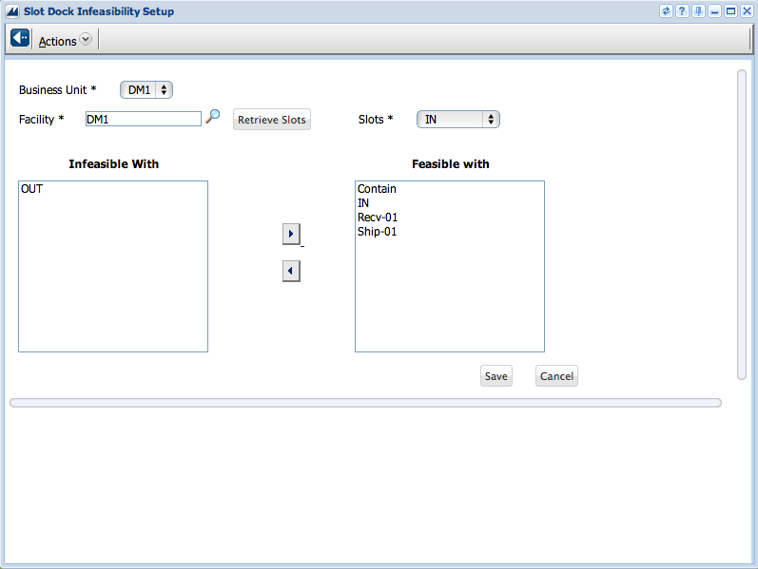
Dock Doors
Created with a barcode used for validation
Can be linked to a receiving staging location for automatic locating of iLPNs during receipt
Dock Doors are tied to Slots
Slots can be used to separate different uses for dock doors (Inbound vs Outbound) or different types of doors (Automated vs Manual)

Slide 48
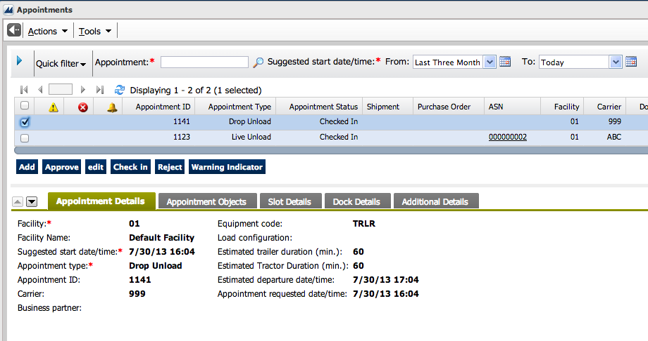
Type of Appointments
Live Unload – Driver remains with trailer until unloaded
Drop Unload – Trailer or Container left at Distribution Center
Pick up Empty – Driver picking up empty trailer (typically from Drop Unload)
Drop Empty – Driver dropping an empty trailer (typically for Drop Load)
Live Load - Driver remains with trailer until loaded
Pick up Load – Driver picking up loaded trailer
Miscellaneous – Typically utilized for non-tracked shipments (Empty Pallets)

Slide 49
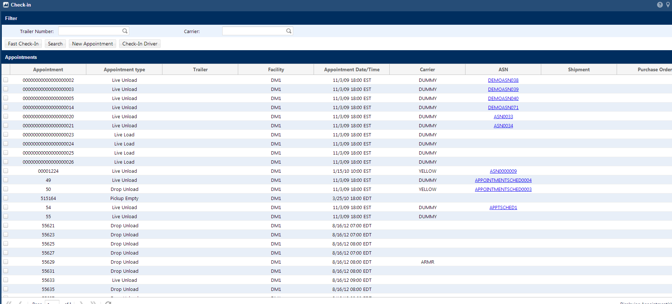
Guard Check-In
The Guard Check-In process checks in the appointment and the associated trailer for that appointment.
There is additionally a “Fast Check-In” option which allows for expedited admittance to the yard.
Or an option to Check In just the driver without an appointment.

Slide 50
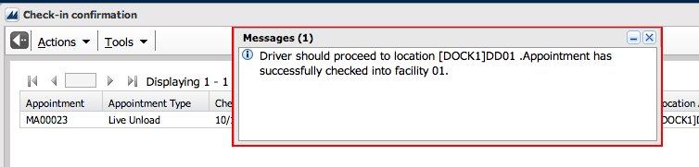
Guard Check-In
WM directs the Guard on where the driver should proceed to:
Dock Door
Yard Location
WM completes move of trailer to destination location
WM prints Facility Access Pass (optional)

Slide 51
Yard Move Trailer
Task List
1 M::[DM1]YARDBB02
2 M::[Ship-01]075
S=> __
Yard Jockeys are displayed different types of task (i.e. Move Trailer or yard Audit Tasks). The user selects the task to execute.
Move Trailer
Destination Location
Cloc:[DM1]YARDBB02
Carrier:YELLOW
Trailer:
TRL08
Dloc:[IN]01
IN01__
WM displays the current location and trailer to be moved as well as the destination. User key enters the destination to confirm the move.

Slide 52
Yard Audit
Yard Audit
Audit Location:
Y11Y11_________
WM prompts for the yard location which is to be audited. User key enters location.
Yard Audit
Is Trailer At Locn
Y
Location:
[YardZone01]Y11Y11
User captures if trailer is currently located in the yard location being audited.
Yard Audit
Trailer:
TR00981____
Location:
[YardZone01]Y11Y11
Counted:
0 of 1
If ‘Y’, WM prompts for the trailer number. User key enters the trailer number to complete the audit.

Slide 53
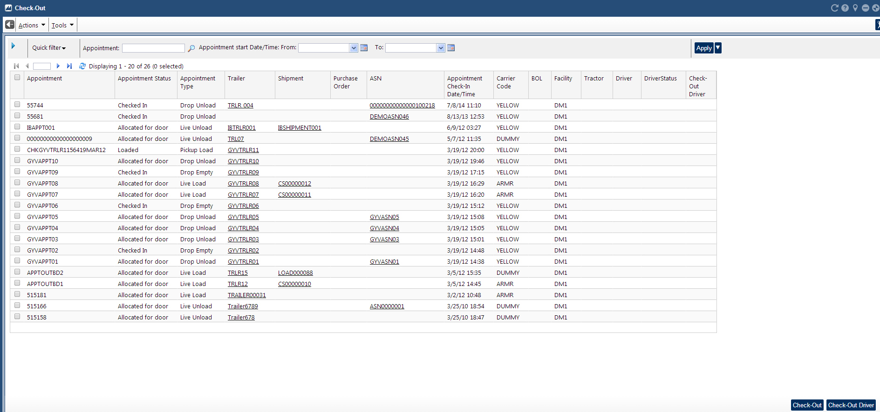
Guard Check-Out
Guard Check Out removes the trailer from the yard.

Slide 54
Receiving

Slide 55
Terminology
Term | Definition
iLPN | Inbound license plate number which uniquely identifies a moveable unit of inventory in the warehouse.
Pallet | Parent license plate number which ties multiple iLPN’s together systemically representing a physical pallet/cage cart/gaylord.

Slide 56


LPN Inventory
Inventory tracked by unique license plate
LPN ID for Physical Case
LPN ID for Physical Pallet
Notes:
Case Inventory
A case in WM is a moveable unit in the warehouse with a tracking number or label. WM can track many different physical objects as cases, for example:
• A box
• A box on a pallet
• A pallet
• A trolley holding shirts
• A plastic bin

Slide 57
Receiving Templates
LPN Level Receiving | Executed via RF
 | Scan iLPN Label to Acknowledge Receipt
 | Ability to Verify Contents (Optional)
Item Level Receiving | Executed via RF
 | Use Blind iLPN or System Generated
 | Scan or Enter Item Barcode
 | Enter Quantity
 | Completion of iLPN Acknowledges Receipt
Returns Receiving | Executed via RF
 | Use Blind iLPN or System Generated
 | Scan or Enter Item Barcode
 | Enter Quantity
 | Enter Returns Disposition Code
 | Completion of iLPN Acknowledges Receipt

Slide 58
RF Receiving ASN Identification
Receive Item Lvl
Dock Door:DD01__
If utilizing Yard Management, WM prompts for dock door. Otherwise this is skipped.
Receive Item Lvl
Dock Door:DD01
ASN:
ASN082601________
If the door is associated to an ASN through an appointment, then WM displays the ASN. Otherwise the user enters the ASN.
Receive Item Lvl
ASN:
ASN082601________
If Yard is not used, WM directly prompts for the ASN and the user enters the ASN.

Slide 59
RF Receiving LPN Level
Receive LPN Lvl
Dock Door:DD01
ASN:
ASN082601
LPN:
ILPN009901_________
WM prompts for LPN and user scans or key enters the LPN number. WM receives the LPN confirmed by the user.

Slide 60
RF Receiving Item Level
Receive Item Lvl
Dock Door:DD01
ASN:
ASN082602
LPN:
ILPN990001_________
The user scans a blind next-up iLPN label
Receive Item Lvl
LPN:
ILPN990001
Item Barcode:
CAM1000____________
The user scans / enters the item in the iLPN
Receive Item Lvl
LPN:
ILPN990001
Item:CAM1000
Qty:50___ Pack
The user enters the quantity to receive into the iLPN. WM receives the iLPN, SKU and quantity specified by the user.

Slide 61

Perpetual Inventory Transactions
PIX
Insures these two inventories match!!!
HQ (ERP):
Orders entered into the system are bridged into WM input tables; warehouses are aware of needed inventory
Warehouse:
Inventory changes, in response to:
Orders (ERP)
Returns
A variety of other things (you drop a box full of glass…)

Slide 62
Perpetual Inventory Transactions
Perpetual Inventory Transactions (PIX) will:
Inform host of:
Four-wall inventory changes
Allocatable and unallocatable inventory
Host performs soft allocation
Send orders when enough allocatable inventory
WM tells host of increasing inventory
Allocatable or unallocatable
Notes:
The Smart Warehouse Initiative
The Smart Warehouse Initiative is an enterprise wide movement to empower warehouse managers and associates to gain the knowledge and tools to optimize their operations. Three separate movements are enveloped within this initiative. These include labor management, warehouse optimization, and operations management. Manhattan is in the process of developing new products to support the initiative as well as incorporating some current free-standing products.
Labor Management
Manhattan has incorporated the use of Productivity Manager® to manage this piece of the initiative. Labor forecasting, pay incentive programs, and activity based costing can be managed through this tool.
Warehouse Operations
Optimization of picking paths can be accomplished by effective slotting of products in active locations. Manhattan has incorporated the use of Slot-It ® to manage this initiative and will be developing additional functionality in support of this.
Operations Management
This portion of the initiative allows managers to identify operational “bottlenecks” at the onset of the problem and allow them to develop a solution to resolve the issue. Simulators and alerts will be used to provide real time alerts of issues as well as give the ability to forecast and plan workloads.

Slide 63
Status Codes
WM uses status codes to show the progress of an entity through the warehouse.
Process | LPN status |  | ASN status
 | LPN Level | SKU Level
ASN BRIDGED FROM HOST | IN-TRANSIT | N/A | IN-TRANSIT
RECEIVE SHIPMENT | IN INVENTORY, NOT PUTAWAY |  | In RECEIVING
QUALITY HOLD RELEASE | NO CHANGE |  | NO CHANGE

Slide 64
Finalizing Receipt

Slide 65

ASN Verification Templates
Via RF | User presses CTRL-Z to Verify ASN upon completion of RF Receiving
 | Configuration to allow verification only if not 100% match
 | Generates verification PIX transactions to host
Via UI | Receiver turns in paperwork to Receiving Clerk
 | Receiving Clerk researches discrepancies
 | Generates verification PIX transactions to host

Slide 66
RF Verify ASN
ASN:
ASN082602
Status:
30 Receiving Started
Ship Qty:80.0
Recv Qty:80.0
Verify ASN (Y/N):Y
From the RF Receiving or RF ASN Inquiry the ASN can be verified. The user is displayed the expected and received quantities. Configuration controls if the user is allowed to Verify an ASN not complete.

Slide 67
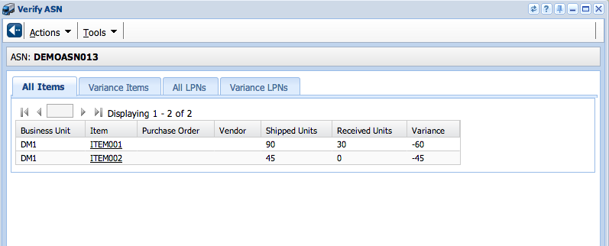
UI Verify ASN
From the UI, the user views any variances for the ASN. The user has the ability to print a ASN variance report or verify the variance.

Slide 68
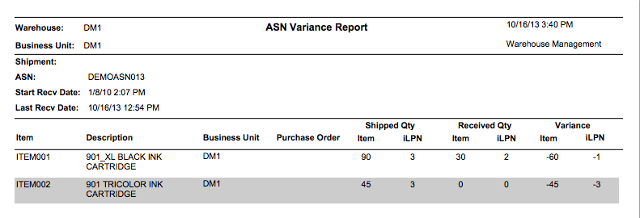
ASN Variance Report
The ASN Variance Report displays the Items and Quantity discrepancies between expected quantity and received quantity

Slide 69
Putaway

Slide 70
Overview
Inbound Receiving: Warehouse Flow
Active
Reserve
Inbound
Inventory
Inventory placement: may be left to the Receiver to decide, or WM may provide instructions.

Slide 71
Overview
Review: Definition
Putaway: the process of moving iLPNs or pallets to reserve or active
User-Directed or System-Directed

Slide 72
Overview
User-Directed
System confirms and performs updates
System-Directed
Requires configuration
Minimize decision making

Slide 73
Putaway Updates
iLPN
Status changes from ‘In Inventory, Not Putaway’ to ‘Putaway’
Location field updated
‘Pending Putaway’ lock code removed, if applicable. PIX written if no more lock codes on iLPN.
Reserve Location
Current UOM Quantity increased

Slide 74
Status Chart
Process | iLPN Status |  | ASN Status
 | iLPN Level | SKU Level
ASN BRIDGED FROM HOST | IN-TRANSIT | N/A | IN-TRANSIT
RECEIVE SHIPMENT | IN INVENTORY, NOT PUTAWAY |  | IN-RECEIVING
QUALITY HOLD RELEASE | NO CHANGE |  | NO CHANGE
VERIFY RECEIPT | NO CHANGE |  | VERIFIED
PUTAWAY | PUTAWAY |  | NO CHANGE

Slide 75
User Directed Putaway
Define User-Directed Putaway.
List the fields in the Location Tables required for User-Directed Putaway.

Slide 76
Overview
User Directed Putaway: process
A user scans the iLPN barcode
RF screen updates: iLPN number appears, and a blank Location field displays
User then scans the location to update this field
In Pallet mode, scanning an iLPN on a Pallet puts away all iLPNs on the pallet, in the same location.

Slide 77
Required Reserve Location Fields
Field | User-directed
LOCATION ID
ITEM DEDICATION TYPE
PUTAWAY ZONE
WORK GROUP/WORK AREA
CURRENT QUANTITY
MAXIMUM QUANTITY
MAXIMUM WEIGHT
MAXIMUM VOLUME
X
X

Slide 78
System Dirceted Putaway
A method of Putaway in which the system directs the user to where inventory should be located.

Slide 79
Methods
Methods of System-Directed Putaway:
Suggested (to Reserve)
Directed (to Reserve)
Direct to Active/Case-Pick
Radial
Case Consolidation

Slide 80
The “Everything” Warehouse
Security Area
Bulk Area

Slide 81
System-Directed Putaway Methods
Suggested (to Reserve)
Suggests a location
Anywhere within the Putaway Zone
Enhanced efficiency, minimal configuration
Ignores capacity

Slide 82
Suggested (to Reserve): Example
Everything, Inc. is setting up Suggested Putaway for its new item, Gas Grills. In the Item table, Gas Grills have been assigned a Putaway Type of Big Items.
All LPNs with a Putaway Type of Big Items should be directed to the reserve aisle BLK-01-1-1 but are allowed to be located in any location within the Bulk Putaway Zone.

Slide 83
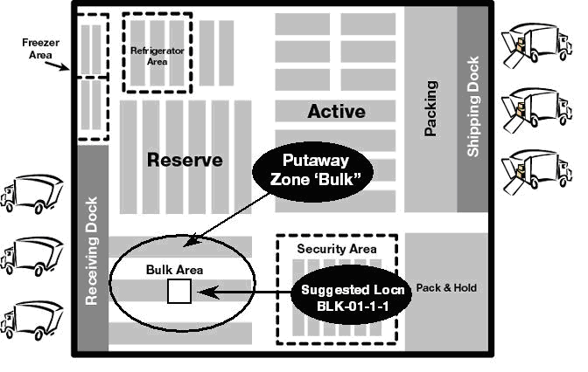
Suggested (to Reserve)

Slide 84
System-Directed Putaway Methods
Direct (to Reserve)
Specific location
Capacity
Item Dedication Type
Putaway Zone Priority
Optimizes Putaway process
Eliminates decision making by warehouse personnel

Slide 85
Direct (to Reserve): Example
Everything, Inc. has decided that all iLPNs containing ice cream will be assigned a Putaway Type of Frozen Foods. All iLPNs with a Putaway Type of Frozen Foods will be directed to the Putaway Zone Frozen Zone 1.
If there is no space in Putaway Zone Frozen Zone 1, then the iLPN should be directed to the Putaway Zone Frozen Zone 2.

Slide 86
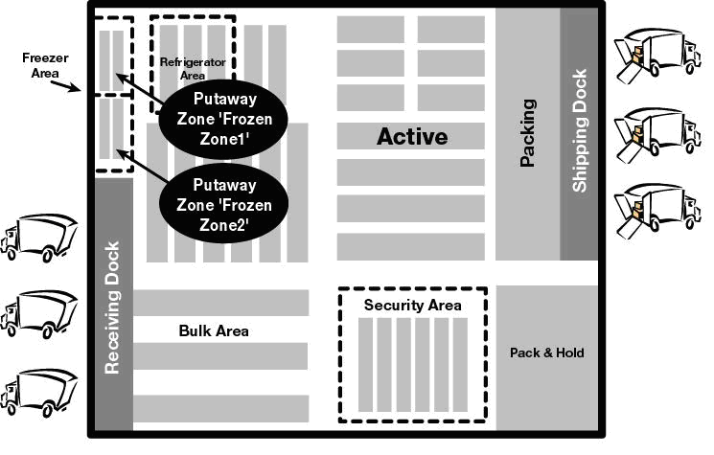
Direct (to Reserve)

Slide 87
System-Directed Putaway Methods
Direct to Active/Case Pick
RF transaction Direct PA–LPN
Single item LPNs
1st check – Does this item have an active/case pick location?
If not, assign new Active/Case Pick location
And/Or
2nd check – If this item has a location, does it need replenishment?
If so, replenish existing location
Multi-item LPNs, split iLPN to:
Assign locations or
Replenish locations

Slide 88
Direct to Active/Case-Pick: Example
Everything, Inc. would like to keep the active locations for small items full. All toothbrushes have been assigned a Putaway Type of Small Items in the Items Menu.
The first priority of all LPNs assigned a Putaway Type of Small Items is to replenish any existing active locations for the item. If the current active locations are full, then the LPNs should be directed to the Putaway Zone Regular.

Slide 89
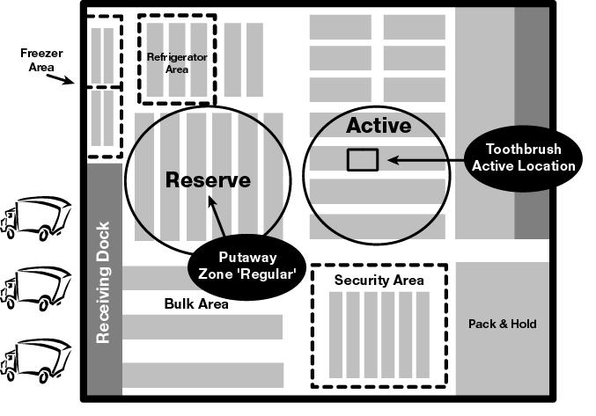
Direct to Active/Case-Pick

Slide 90
System-Directed Putaway Methods
Radial
Closest to location (Within a specified radius)
Three methods:
Direct to Radial around Active
Direct to Radial around Case-Pick
Direct to Radial around Preferred Location

Slide 91
Radial: Example
All sizes of eggs have been assigned the Putaway Type of Eggs and all must be stored in the protected locations of the refrigerated section of Reserve. The preferred (and safest) location is R05-03-2-1.
Once that location is full, LPNs of eggs can be located in locations that are at most 1 bay away.

Slide 92
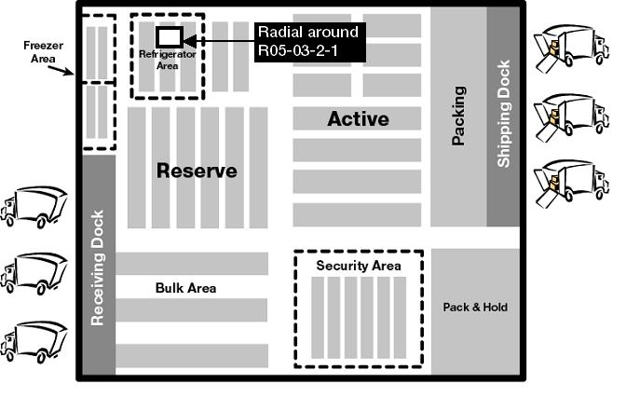
Radial

Slide 93
System-Directed Putaway Methods
iLPN Consolidation
Transaction Parameter Settings
Added to existing LPNs in Reserve
Consolidated into one or multiple locations

Slide 94
iLPN Consolidation: Example
All types and sizes of paper have been assigned to the Paper putaway type. Paper is shipped to the warehouse as one case per LPN, however, Everything, Inc likes to store paper as 20 cases per LPN in Reserve with each case being a pack quantity.
As each case of paper is putaway to reserve, WM will add it to an existing pallet that has less than 20 cases and the same type of paper. If no pallet exists, then WM will direct the case to a location in the Regular Putaway Zone.

Slide 95
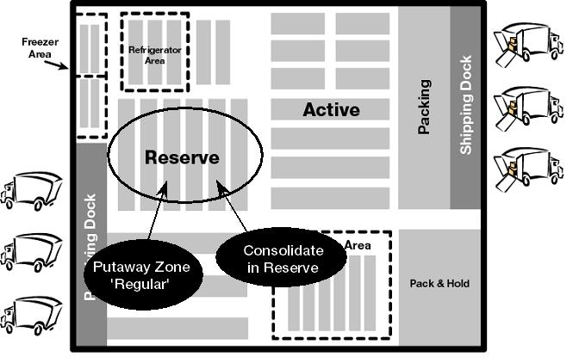
iLPN Consolidation

Slide 96
Methods
Methods of System-Directed Putaway:
Suggested (to Reserve)
Directed (to Reserve)
Direct to Active/Case-Pick
Radial
Case Consolidation

Slide 97
RF System Directed Putaway
Ptwy iLPN
iLPN:
ILPN009901__________
The putaway associate scans a iLPN to pickup
Ptwy iLPN
iLPN:
ILPN009901
Rloc:NC03-101-A1
Rloc:NC03-101-A1____
WM displays the destination location (either drop zone or final location). The user scans the location to confirm the iLPN putaway

Slide 98
RF Tasking Putaway
Update Task Group
Task Group:RT_
Locn:_______________
The putaway associate signs into a task group and scans their current location
Task:3941
Container:
ILPN913001
Rloc:SORT-01-01
Container:
ILPN913001_________
WM displays the pickup and the iLPN to pickup. The user scans the iLPN to confirm the iLPN pickup.
Ptwy iLPN
LPN:
ILPN913001
Rloc:99-01-027A
Rloc:9901027A_______
WM displays the destination location. The user scans the location to complete the iLPN putaway

Slide 99
RF System Directed Putaway Alternate
Ptwy iLPN
LPN:
ILPN913001
Rloc:99-01-027A
Rloc:_______________
The user is directed to a location but cannot complete the putaway. The user presses CTRL-P to ask for an alternate
Create CC Task (Y/N)
Y_
WM either prompts the user whether a Cycle Count task should be created or automatically creates a Cycle Count Task
Ptwy iLPN
LPN:
ILPN913001
Rloc:99-01-027B
Rloc:9901027B_______
The user is directed to an alternate location. The user scans the location to confirm the iLPN putaway

Slide 100
RF User Directed Putaway
Ptwy iLPN
iLPN:
ILPN009901__________
The putaway associate scans a iLPN to pickup
Ptwy iLPN
LPN:
ILPN913001
Rloc:9901027B_______
The user scans the putaway location to confirm the iLPN putaway

Slide 101
TASK MANAGEMENT
Notes:
Determine after meeting with david if we will keep YM in presentation

Slide 102
Task Definition
Task
Definition: System directed work!
Tasking involves the system initiation and direction of activities based on the following factors:
Type of work or task
Task priority
Worker eligibility
Type of equipment

Slide 103
Task Definition
Common Tasks:
Directed Putaway
Full case pulls
Pick from active
Cycle counting
Replenishment

Slide 104
Task Definition
What are some advantages of using system directed tasks?
Less communication needed between supervisiors and workers
Operational decisions are made ahead of time
Maximize efficiency by interleaving tasks
Once configured, minimal maintenance is required

Slide 105
Tasking Concepts
Task Group
Groups of people that do similar work
Work Group / Work Area
Physical locations in your warehouse
Task Group Eligibility
What work can the groups do
Where can they do it (work group/area)

Slide 106
Task Assignment and Eligibility
What is a Work Group and a Work Area?
…or maybe the left aisle.
May be the lower row…
(Within the Reserve Work Group)
Reserve
Active
Just an example; you are not constrained to these only!!
Work Group
Work Area

Slide 107
Task Assignment and Eligibility
As a User within the system, you may think of tasks as “split” in 2:
What you have been asked to do and
Where you are going to perform the task

Slide 108

Task Assignment and Eligibility
What: You, the User, are a member of a:
defines what tasks the Pallet Jack Operators can fulfill
Task Group: such as, Pallet Jack Operators
Note:
User: Credentials to login; every user in turn has a…
User Profile: defines your Task Group Membership

Slide 109
Task Assignment and Eligibility
Where: Your Task Group, in turn, has access to a:
Work Area 1: such as, Rack (defines an area within the Reserve Work Group)
Work Group: such as, Reserve
Work Area 2: such as, Location (may have more than one Work Area defined for a Work Group)

Slide 110
Task Assignment and Eligibility
WM will assign tasks according to the Task group eligibility; it will look at the following configurations to know “what to assign to whom”…
Work Area
User Profile
Task Group
Work Group
User
Note: This is an oversimplification, only used to illustrate where to assign these values within the screens

Slide 111
Task Assignment and Eligibility
Why is this all done?
To avoid having tasks assigned to users that have access to the incorrect equipment
Efficiency!!
In the following slides, we will look at these elements in more detail
How do you get this One?
I IIII
Level 5
Level 4
Level 3
Level 2
Level 1

Slide 112
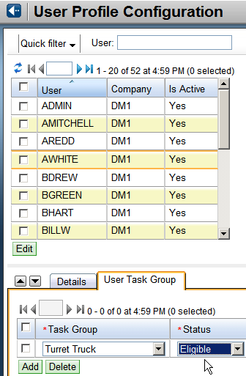
Task Assignment & Eligibility
Task Group Assignment: under the User Profile

Slide 113
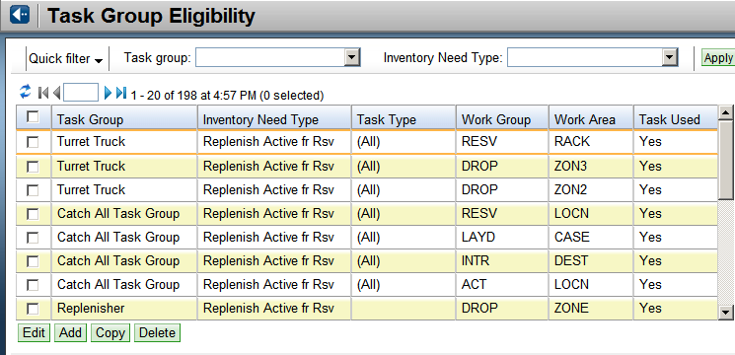
Task Assignment & Eligibility
Task Group Eligibility
Who can work where

Slide 114
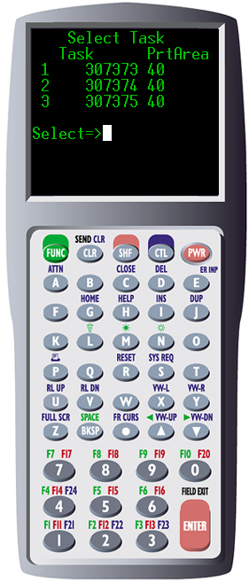
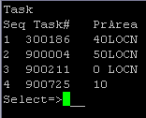
Task Execution: RF
Select Task <Ctrl>+S
Tasks available for current task group
Displays
Task #
Priority
Area

Slide 115
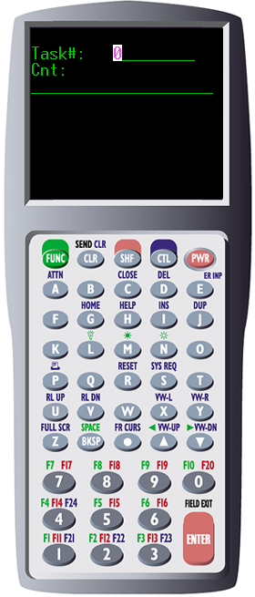
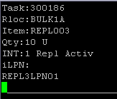
Selecting a Task
Select Task:
Displays:
Task #
Information about task
Location
Container

Slide 116
Count Execution
Notes:
Determine after meeting with david if we will keep YM in presentation

Slide 117
Objectives
Define Cycle Counting and state its purpose.
Identify two ways in which Cycle Counting may be initiated.
State updates that occur when Cycle Counting is performed.

Slide 118
Agenda
Overview
Cycle Count Initiation
Updates
Variance Reports
Task Monitoring

Slide 119
Cycle Count Overview
Physical Count vs. Cycle Count
Both types of counts are used to keep WM inventory and physical inventory in sync.
Physical Count:
Usually performed once a year
Facility shut down for counting
Inventory counted in large areas for the whole facility at one time.
Cycle Count:
Involves periodic counting of small areas
Facility operations can continue
Inventory counted on a location by location basis

Slide 120
Inventory Synchronization Triangle
Host
Inventory Summary PIX
WM
Physical
Physical/Cycle Count

Slide 121
Inventory Summary Transactions
PIX Transactions
Transaction Adjustment
Status Type Code Description SKU ID Qty
U 605 01 Case - Invn Summary 032333 1001
U 605 03 Active - Invn Summary 032333 126
U 605 04 Trans - Invn Summary 032333 1790
U 605 03 Active - Invn Summary 338293 8432
U 605 04 Trans - Invn Summary 338293 59
U 608 13 End of 605 PIX transaction set

Slide 122
Functionality
Scan locations and associated LPNs or Items
Blind count or loop through expected locations
Optionally verify item attributes:
Batch (or Lot)
Country of Origin
Item Serial Numbers
Pack Quantity

Slide 123
Functionality
iLPN tracked locations:
Count at iLPN level
User prompted to confirm either:
Number of iLPNs
Each iLPN
Each iLPN/item/quantity
Reserve – optionally verify attributes:
Manufacture Date
Ship By Date
Expiration Date

Slide 124
Functionality
Item (non-iLPN) tracked locations
User counts at the item level
Validation occurs for each item, if configured

Slide 125
Variances
Warning message at end of location
Exception handling is configurable:
Lost LPNS:
Consumed
Lost in Cycle Count lock code
Unexpected LPNs:
Added to location
Remove previous Lost in Cycle Count lock code
Prompt user for reason code

Slide 126
Variances
Configured to:
Require current user to recount
Two equal, consecutive counts
Create additional Cycle Count task
Current location
Different user
Based on tolerance settings:
Unit
Weight
Dollar
Percentage

Slide 127
Agenda
Overview
Cycle Count Initiation
Updates
Variance Reports
Task Monitoring

Slide 128
Cycle Count Initiation
User-initiated
Cycle Count transactions
System-initiated
Select Task transaction

Slide 129
User Initiated
User specifies location

Slide 130
Cycle Count by Last Count Date
All RF Cycle Count options
Location with oldest Last Cycle Count Date/Time
Last Cycle Count Date/Time updated

Slide 131
Cycle Count by SKU Velocity
RF option Cycle Cnt Rsv/Act by Vlcty
Configured to count Active, Case Pick, or Reserve
User prompted for velocity code
System Code B707
User enters percentage of locations to count
Can default from transaction parameters
System randomly selects locations and prompts user to count

Slide 132
Cycle Count by SKU Percentage
RF option Cycle Cnt Rsv/Case Pick by %
Configured to count Active, Case Pick, or Reserve
User prompted for SKU
User enters percentage of locations to count
Can default from transaction parameters
System selects percentage of locations and prompts user to count
Sequenced by last count date

Slide 133
System Initiated
Physical Count Generated Triggers
Event Generated Triggers
Cycle Count Rules

Slide 134
Physical Count Generated Triggers
Cycle count tasks generated during physical count:
Item variance
Wrong item in active

Slide 135
Event Generated Triggers
Generated during picking and pulling:
Short pick
Alternate pick
Substitution

Slide 136
Event Generated Triggers
Trigger codes (configurable):
Why a cycle count task is generated
Whether to create the cycle count task
How to create the cycle count task
What attributes the count task will have

Slide 137
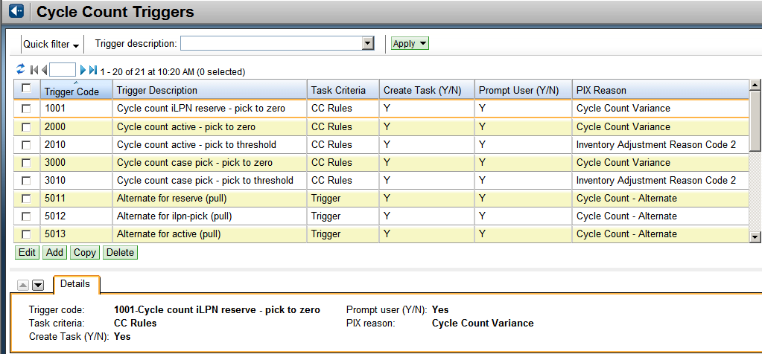
Event Generated Triggers

Slide 138
Cycle Count Rules
User defined rules:
Active locations with Actual < 10 units
Reserve locations with PO = 123
Initiated:
Manually
Automatically (Frequency)

Slide 139
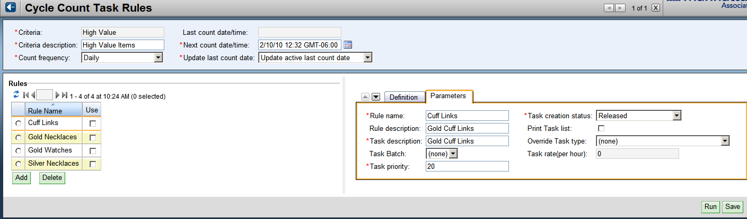
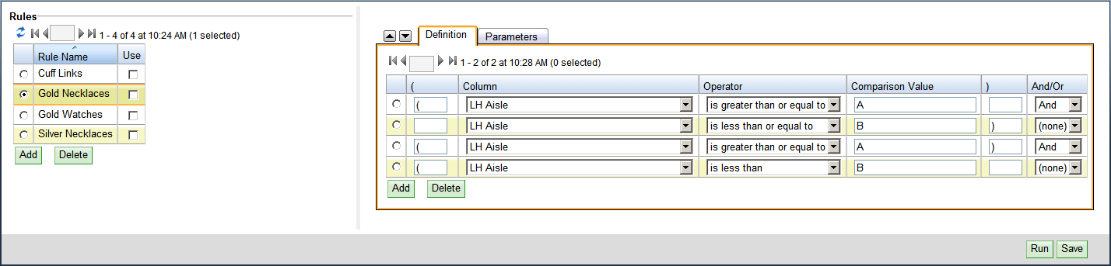
Cycle Count Rules - Template

Slide 140
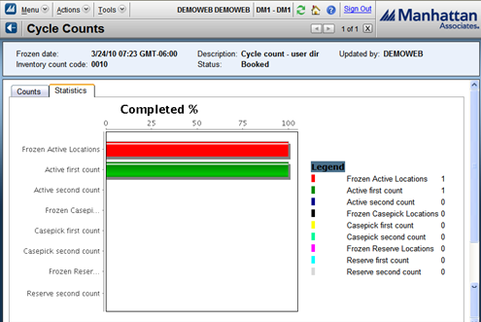
Cycle Count

Slide 141
Agenda
Overview
Cycle Count Initiation
Updates
Variance Reports
Task Monitoring

Slide 142
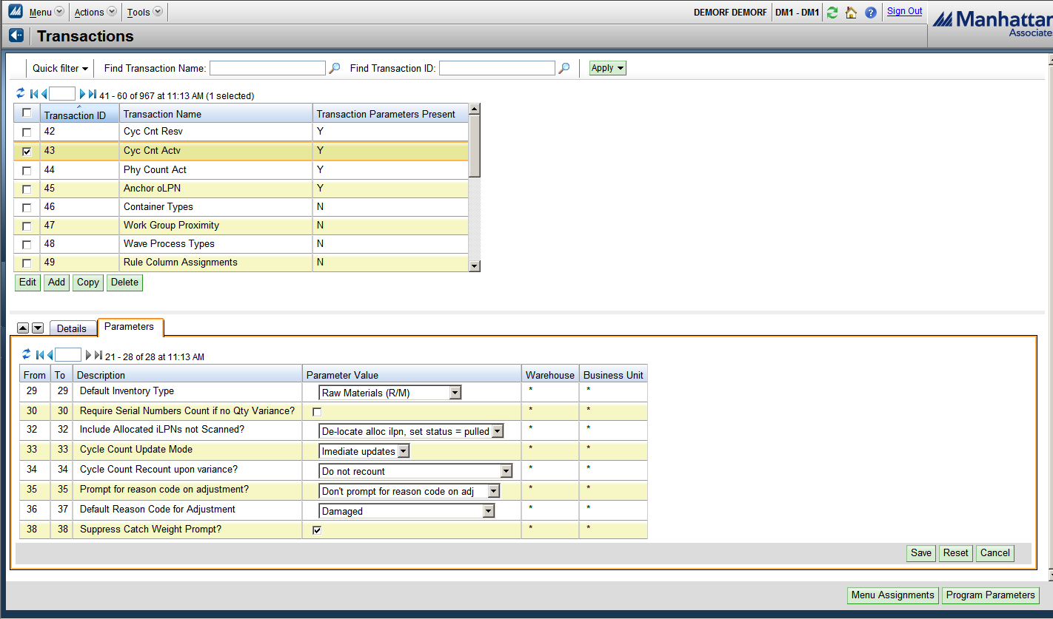
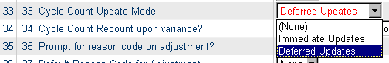
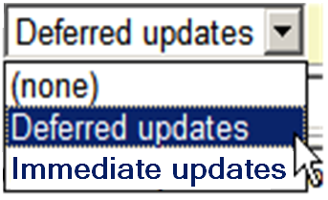
Updates
Transaction Parameter: RF Cycle Count options
Notes:
Under Distribution Management>Configuration>(Under the system Configuration heading) , select one of the Cycle Count Transactions (Transactions Listed here: Cycle Count Active), and Select “Edit”; select Program Parameters” and the screens above will display)

Slide 143
Updates
Immediate updates:
Location
Variance
Re-located LPNs
Last Count Date/Time
Lock codes
LPN header
Lost in cycle
Deleted

Slide 144
Updates
Immediate Updates (cont’d)
Task
Cancel pending/duplicate
Create for variances
PIX creation
Adjustments
Cycle Counts
‘Processed’

Slide 145
Updates
Deferred Updates:
Cycle Counts
‘Unprocessed’
Review
Cycle Counts
Approve or reject (‘Expired’)
Process at Location level

Slide 146
Agenda
Overview
Cycle Count Initiation
Updates
Variance Reports
Task Monitoring

Slide 147
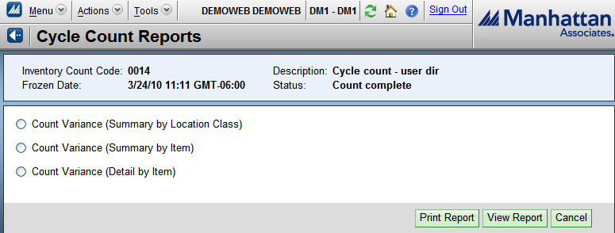
Cycle Count Variance Reports
Cycle Counts:
Summary by Location Class
Detail by Item
Summary by Item

Slide 148
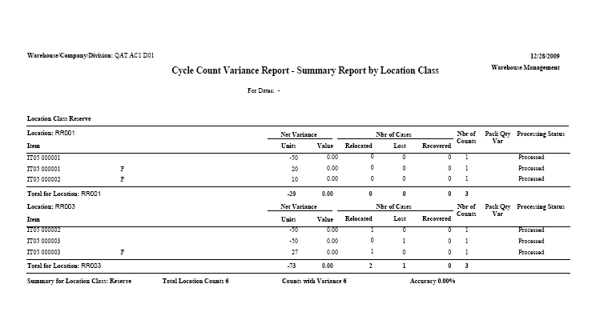
Cycle Count Variance Reports
Summary by Location Class
Displays variance information broken down by location class, location, and item.

Slide 149
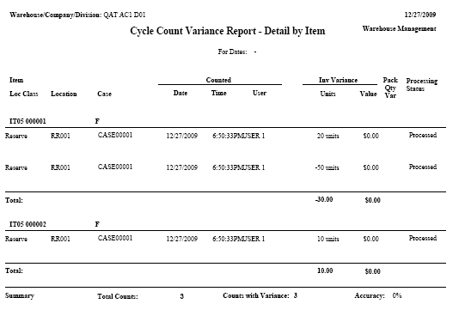
Cycle Count Variance Reports
Detail by Item
Displays variance information broken down by item, location class, and location.

Slide 150
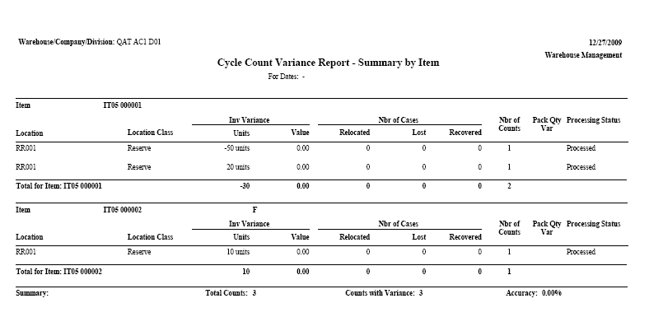
Cycle Count Variance Reports
Summary by Item
Displays variance information broken down by item, location, and location class.

Slide 151
Agenda
Overview
Cycle Count Initiation
Updates
Variance Reports
Task Monitoring

Slide 152
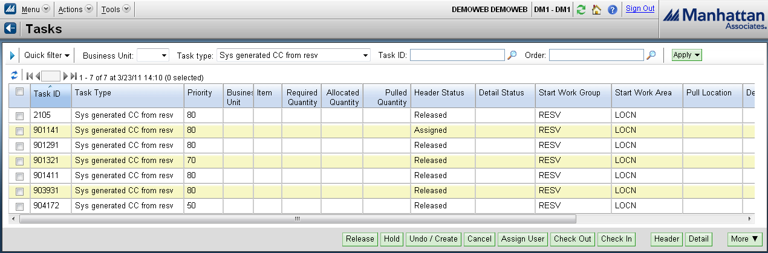
Task List Inquiry
Release, Hold, or Cancel

Slide 153
Cycle Counting Scenarios
Three possible scenarios:
No variance
iLPN counted in different location
iLPN not counted
C000147
CPD : 03/25/10
Vital Stats:
12 X 12 X 10
27 Lbs.
Last Seen : 10/20/10

Slide 154
Cycle Counting Scenarios
User cycle count matches WM inventory
WM Inventory
User Count: 10 cases
WM Updates
Last Cycle Count Date/Time field updated for Location R01 and all iLPNs in that location.
R01
R01

Slide 155
Cycle Counting Scenarios
User cycle count of location R03 includes a case that WM thinks is in location R02
WM Updates
Last Cycle Count Date/Time field updated for Location R03 and all iLPNs in that location
LPN row updated with new location
Actual Qty in R02 decreases, Qty in R03 increases
No PIX Transactions
WM Inventory
User Count
R02
R03

Slide 156
Cycle Counting Scenarios
User cycle counts location R04 and counts 9 iLPNs instead of 10. (Option set to Lock Lost iLPNs)
WM Inventory
User Count:
WM Updates
Last Cycle Count Date/Time field updated for Locn R04 and all iLPNs in that location.
‘Lost in Cycle Count’ lock code applied to iLPN
iLPN status updated to ‘In Inventory, Not Putaway’
PIX transactions
X
R04
R04

Slide 157
Cycle Counting Scenarios
User cycle counts location R04 and counts 9 iLPNs instead of 10. (Option set to Delete iLPNs)
WM Inventory:
User Count:
WM Updates
Last Cycle Count Date/Time field updated for Locn R04 and all iLPNs in that location.
iLPN status updated to ‘Deleted’ (99).
PIX transactions
X
R04
R04

Slide 158
Handling Lost Cases
iLPN Updates:
Removed from 4-wall inventory.
PIXs created.
iLPN to ‘Consumed’ Status.
RF Option:
Consume iLPN

Slide 159
Reporting / Dashboards / Alerts
Notes:
Determine after meeting with david if we will keep YM in presentation

Slide 160

Reporting
Base System (WM, LM, Slotting) Includes Report Writer
Standard reports out-of-the-box
Utilizes JasperReports – open source Java reporting engine
User-definable Dashboards with “Print” capability
Supply Chain Intelligence (optional module)
BI Reporting Engine
Utilizes Cognos
Customer can utilize 3rd Party Reporting Tool if desired

Slide 161
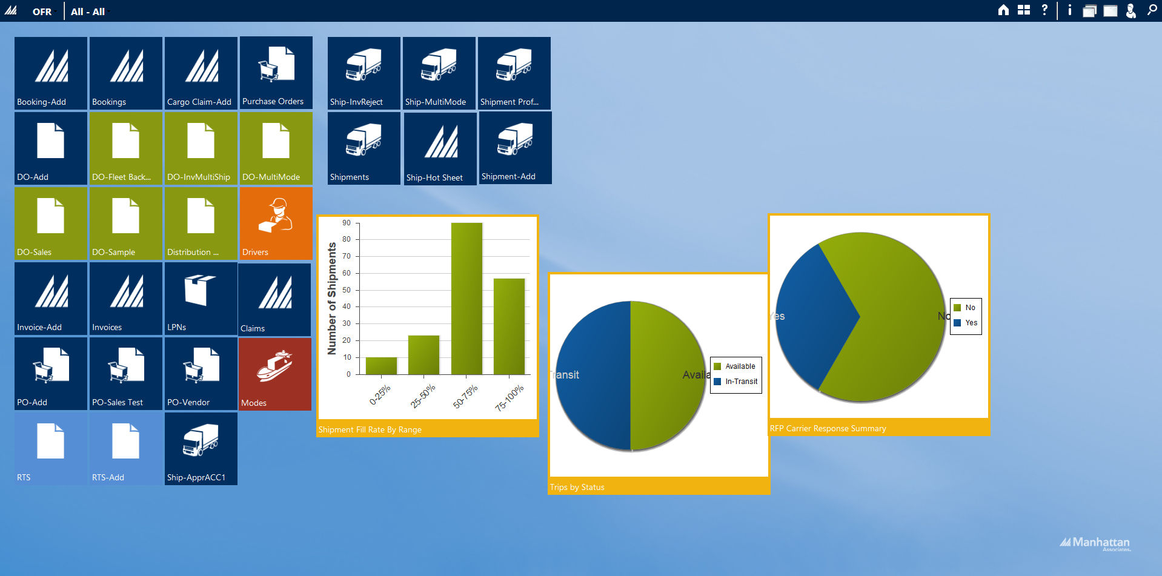
User Interface

Slide 162
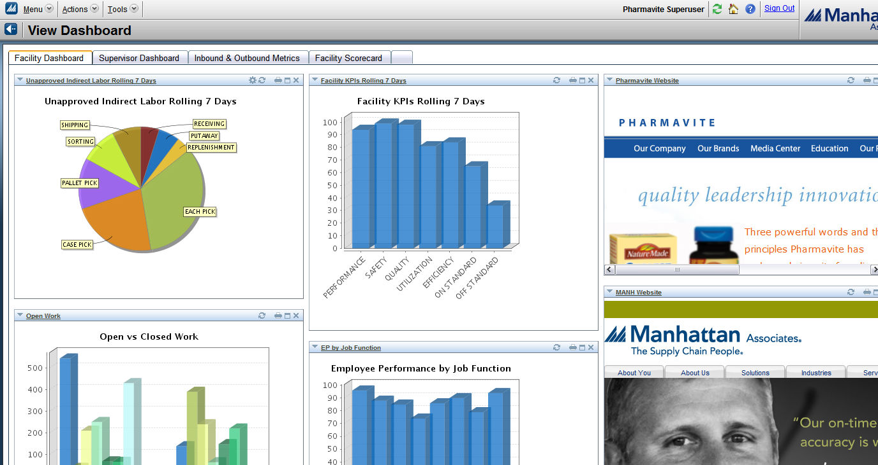
Dashboards

Slide 163
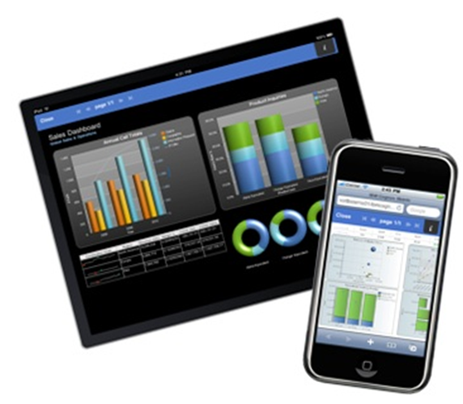
Real-time Information via Dashboards

